Slide 1
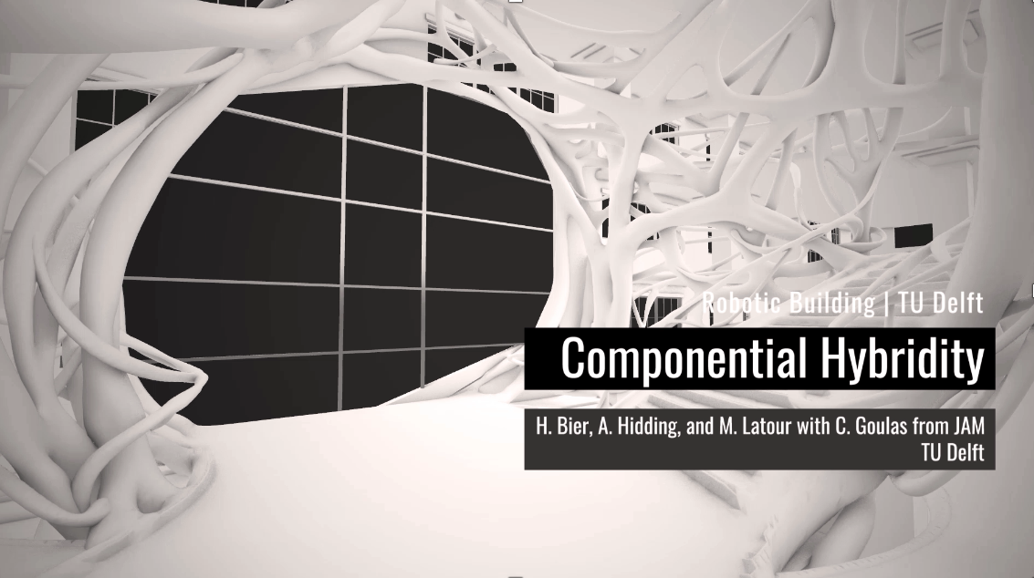
Robotic Building @TUD
Design-to-Robotic-Production (D2RP) for CW4N
WHAT

Slide 2
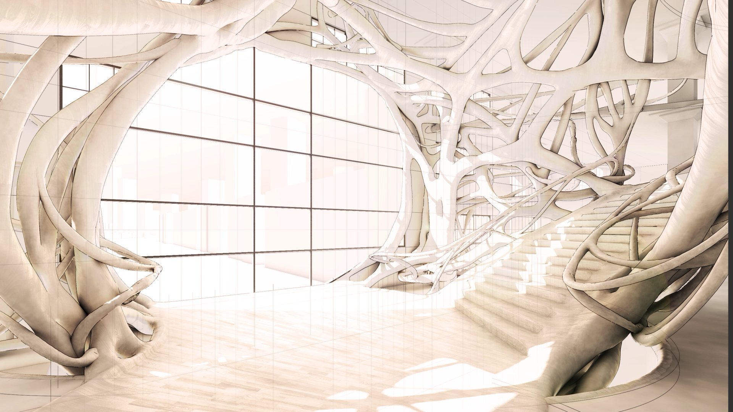

Slide 3
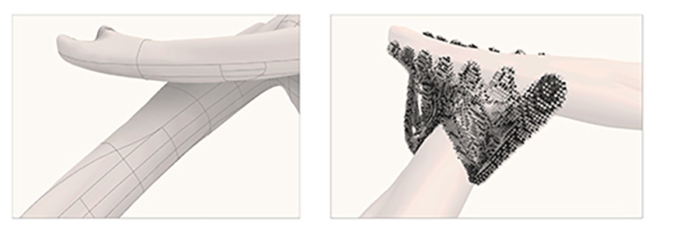
Notes:
Most recent experiment with additive manufacturing involves 3D printing steel

Slide 4
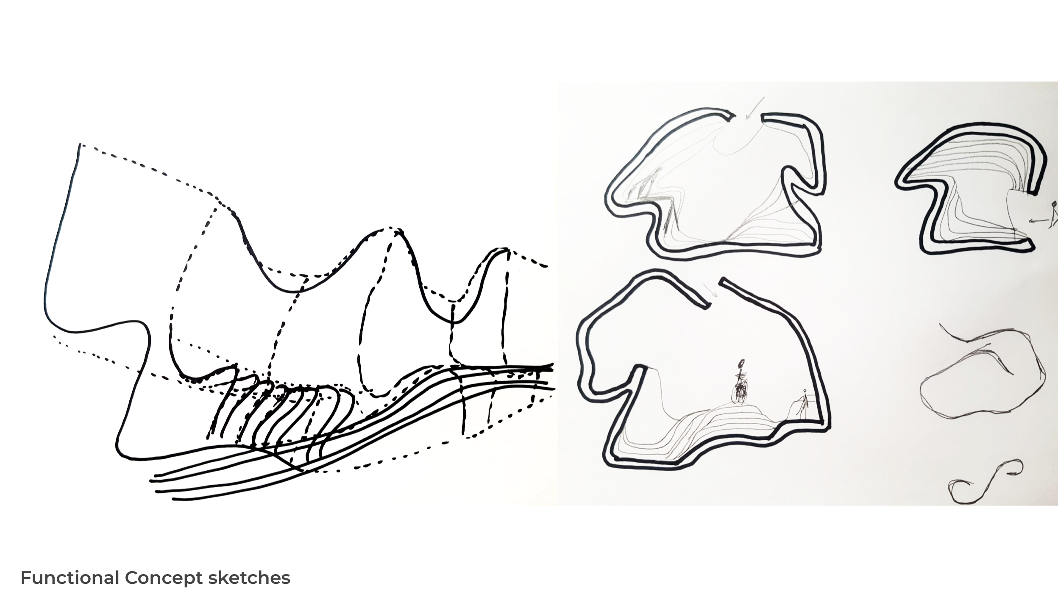
Notes:
Most recent experiment with additive manufacturing involves 3D printing steel

Slide 5
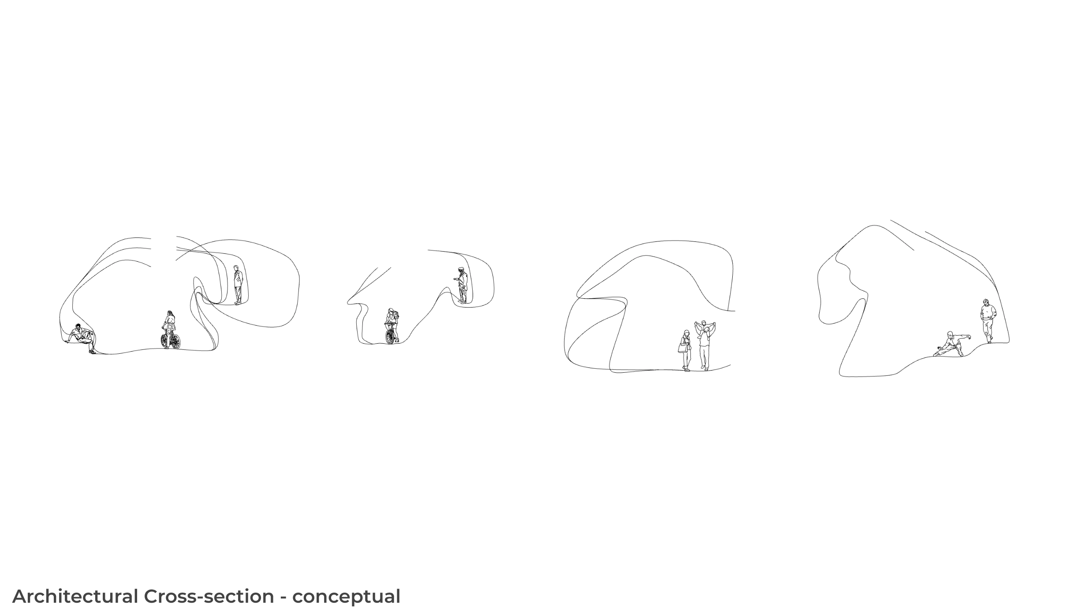
Notes:
Most recent experiment with additive manufacturing involves 3D printing steel

Slide 6
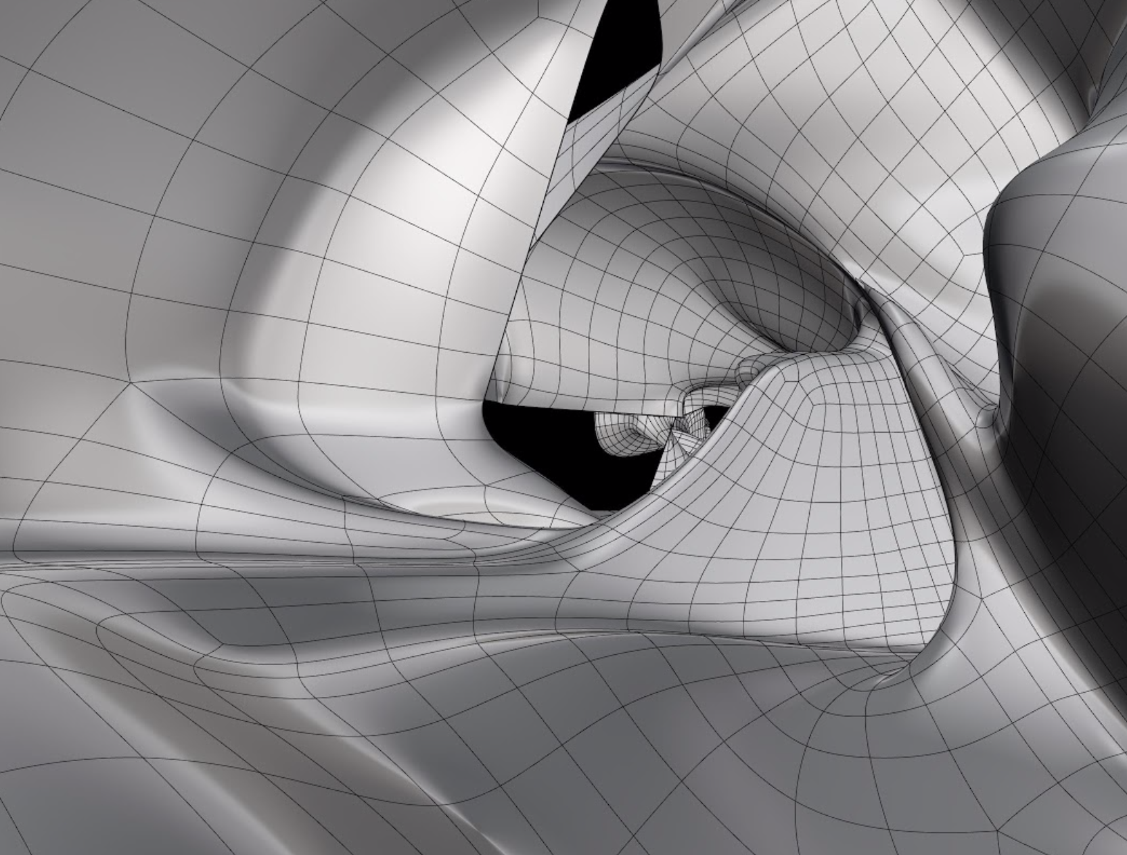
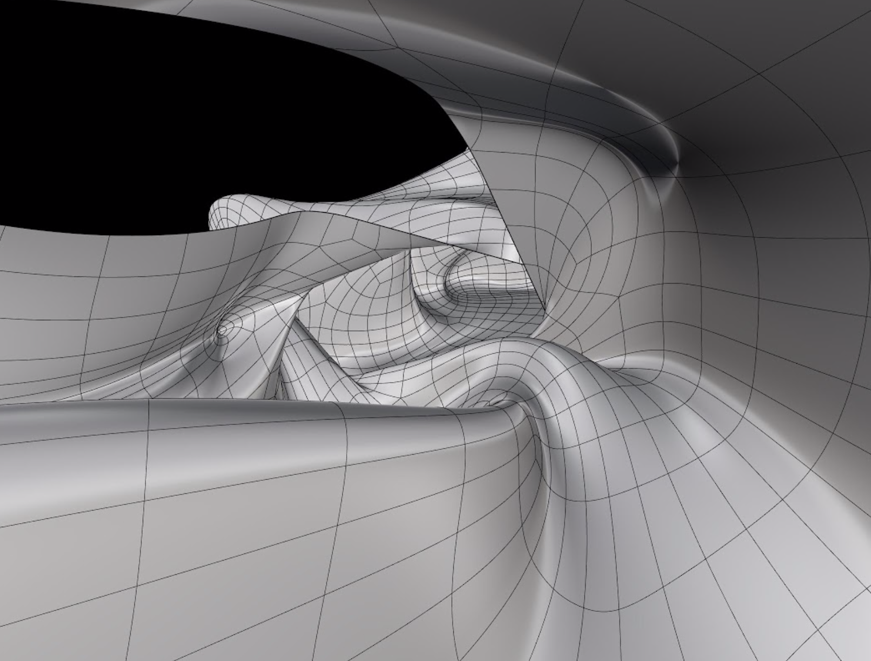
Notes:
Most recent experiment with additive manufacturing involves 3D printing steel

Slide 7
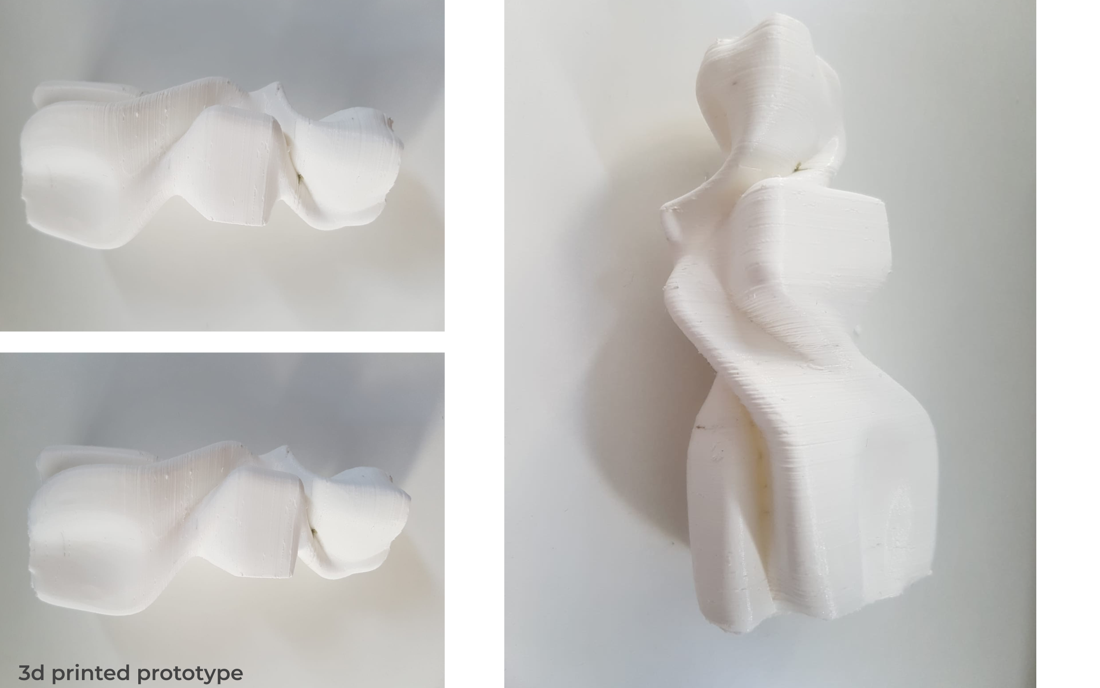
Notes:
Most recent experiment with additive manufacturing involves 3D printing steel

Slide 8
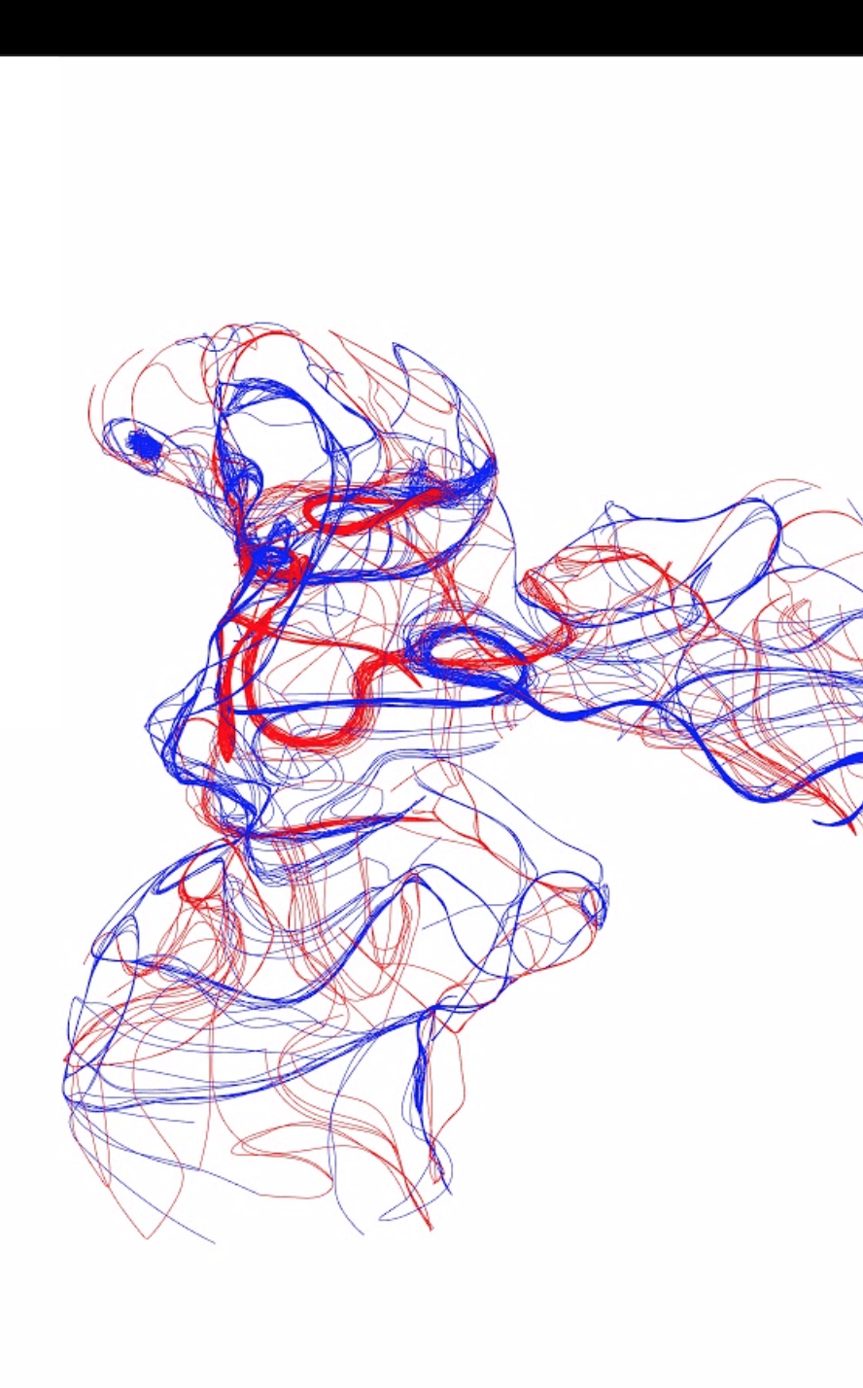
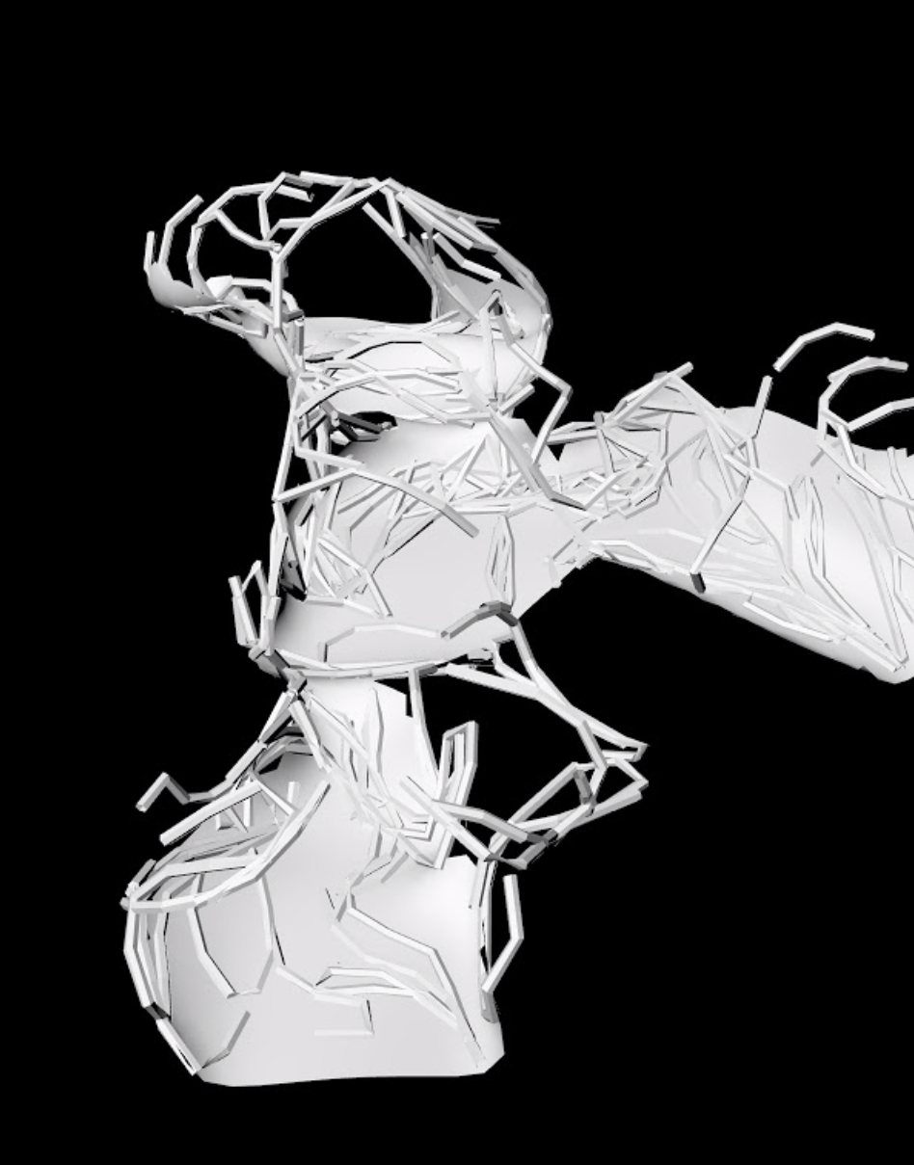
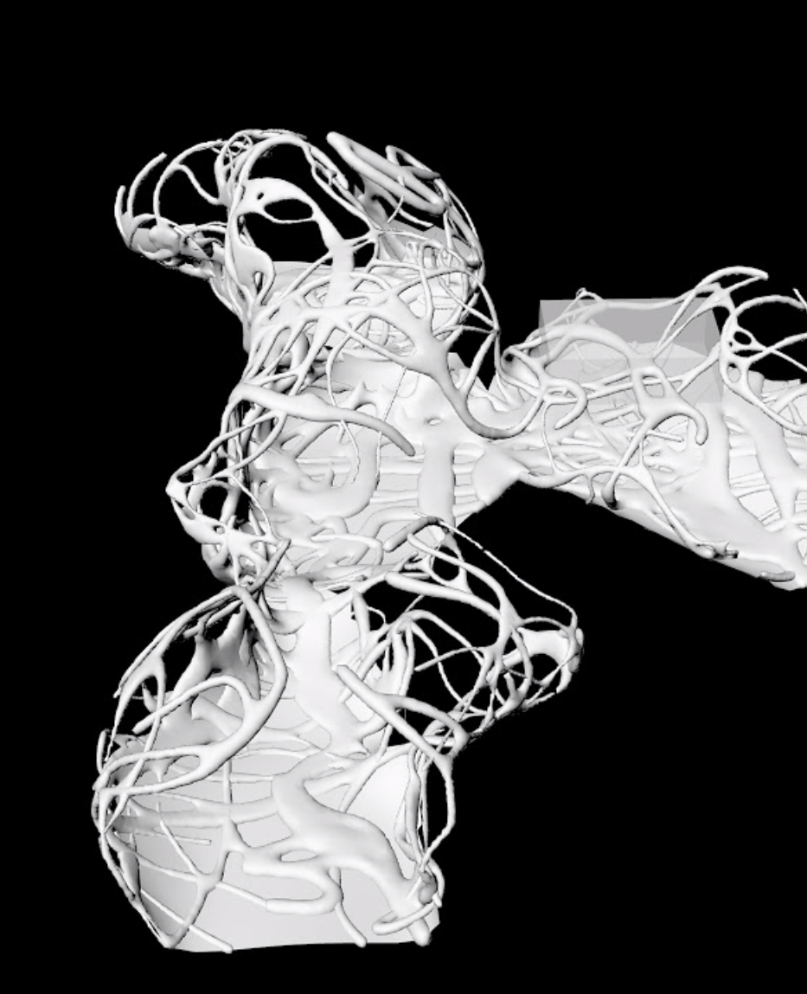
Notes:
Most recent experiment with additive manufacturing involves 3D printing steel

Slide 9
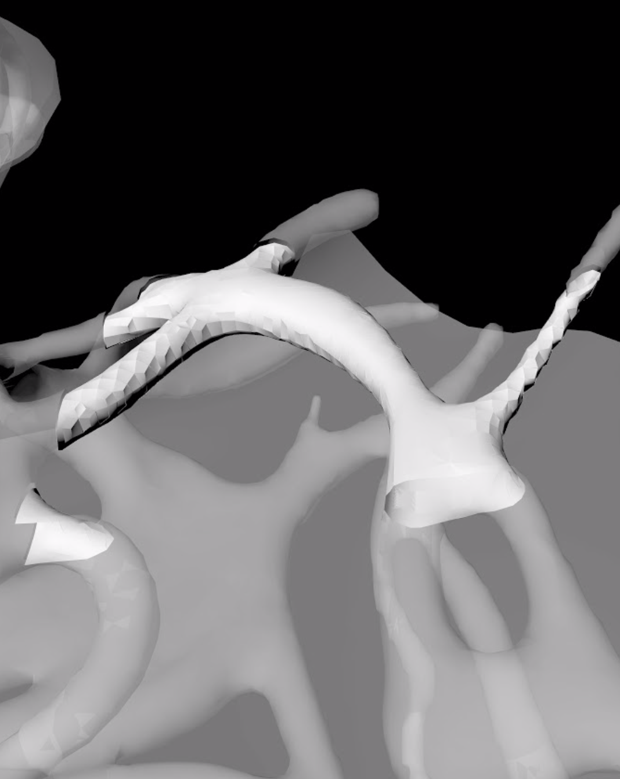
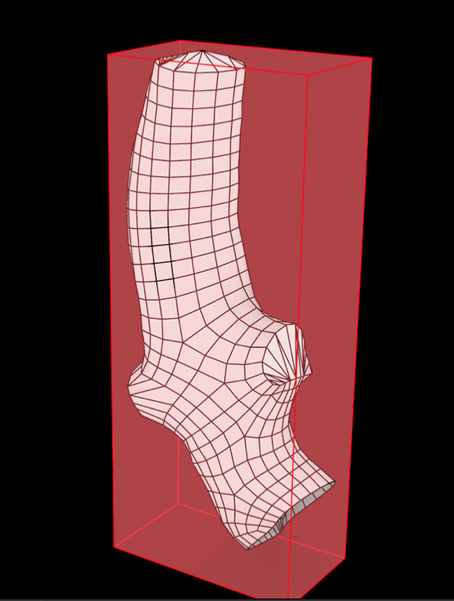
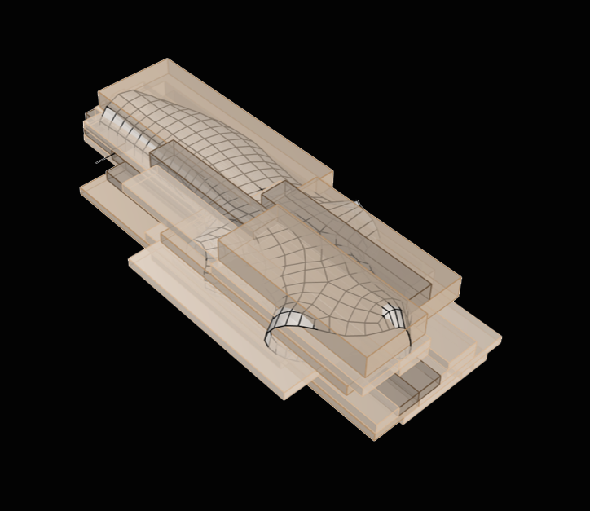
Notes:
Most recent experiment with additive manufacturing involves 3D printing steel

Slide 10
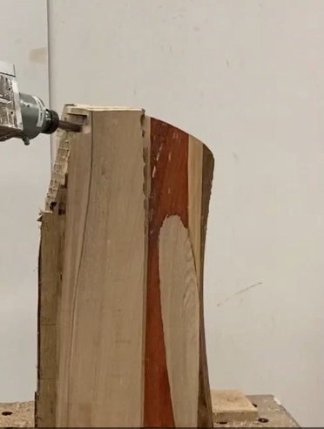
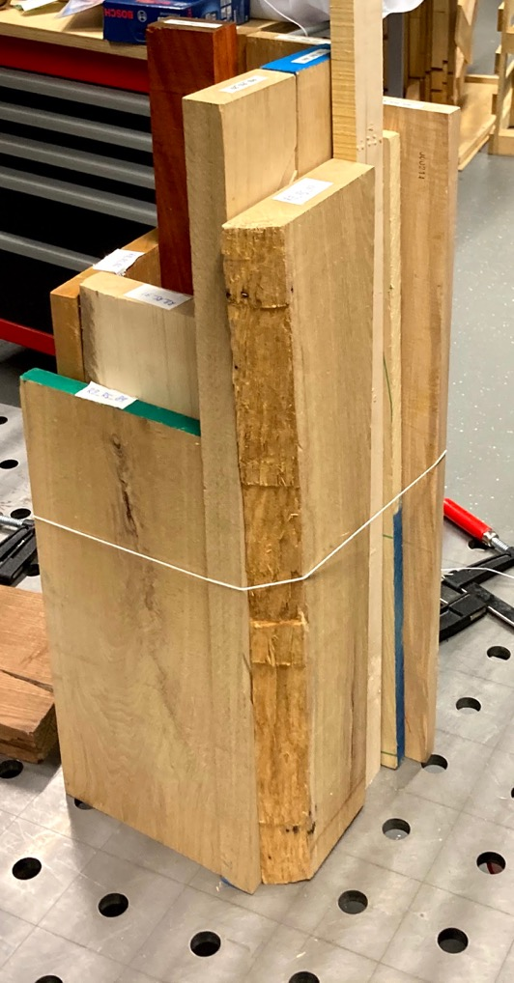
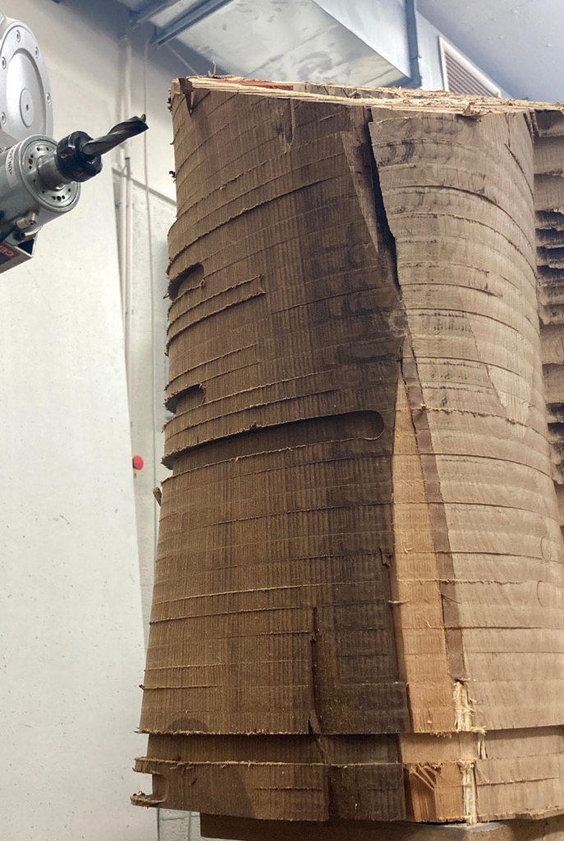

Slide 11
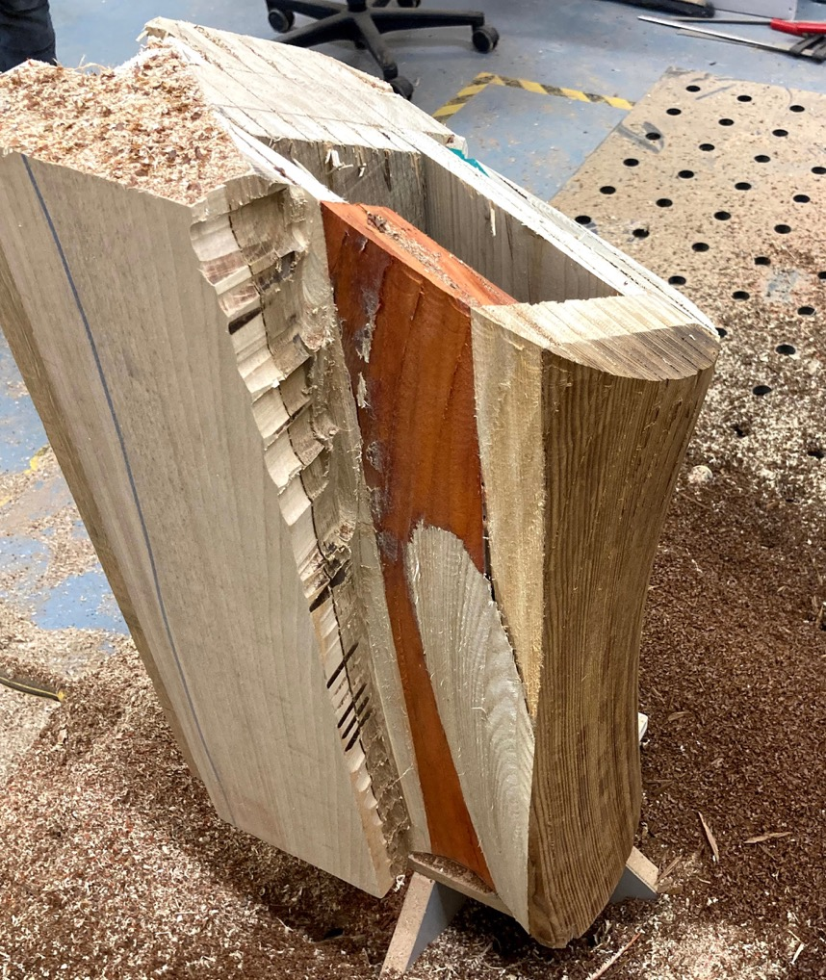
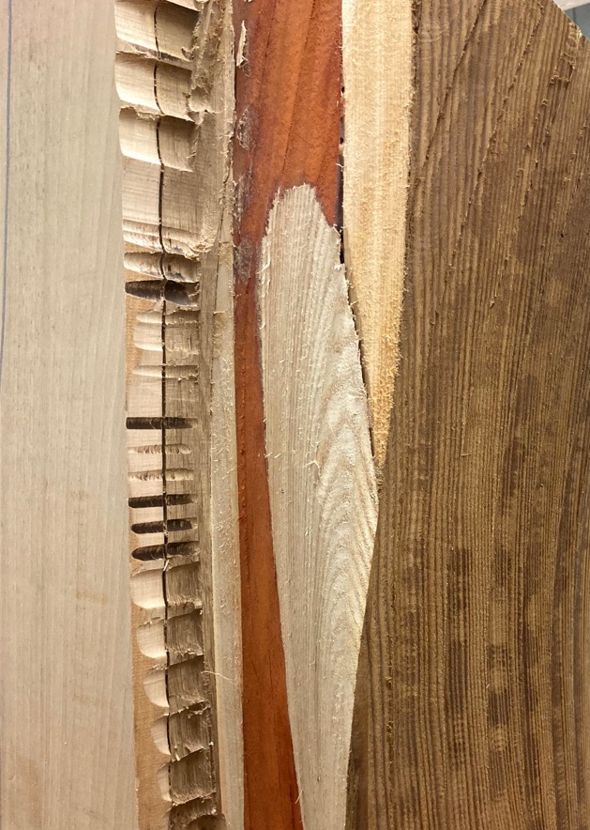
sawdust > 3D print

Slide 12
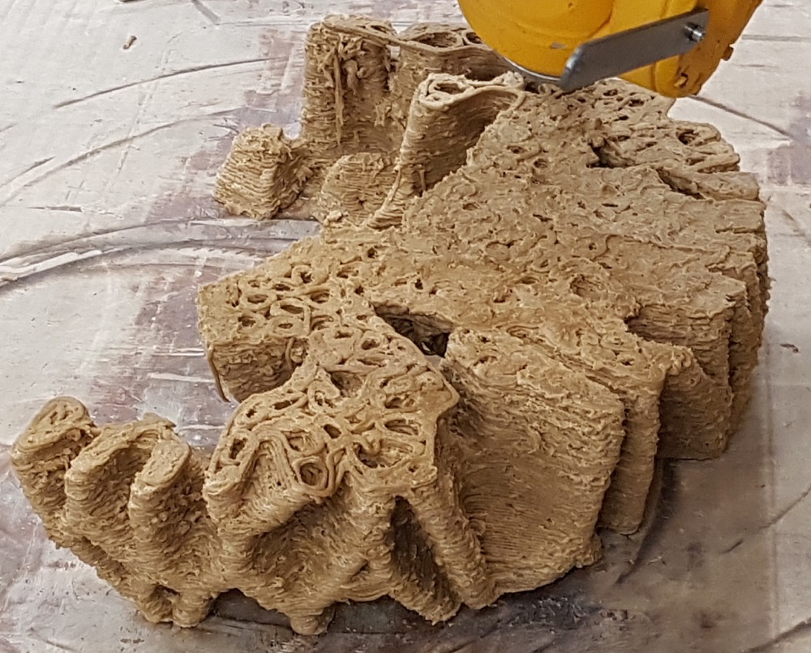
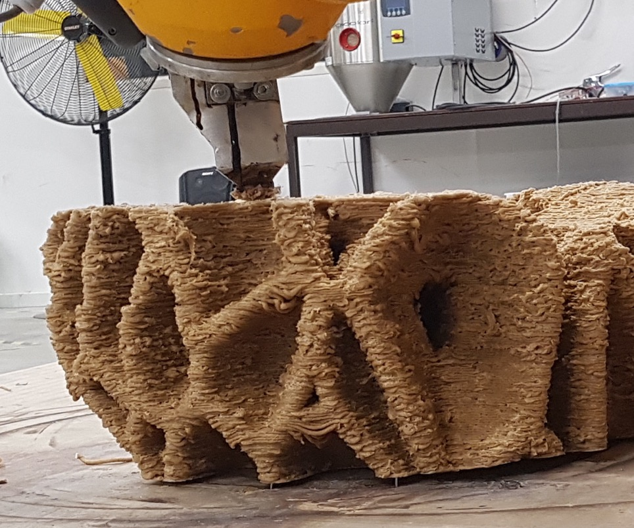
Notes:
And 1:1 scale by prototyping a fragment

Slide 13
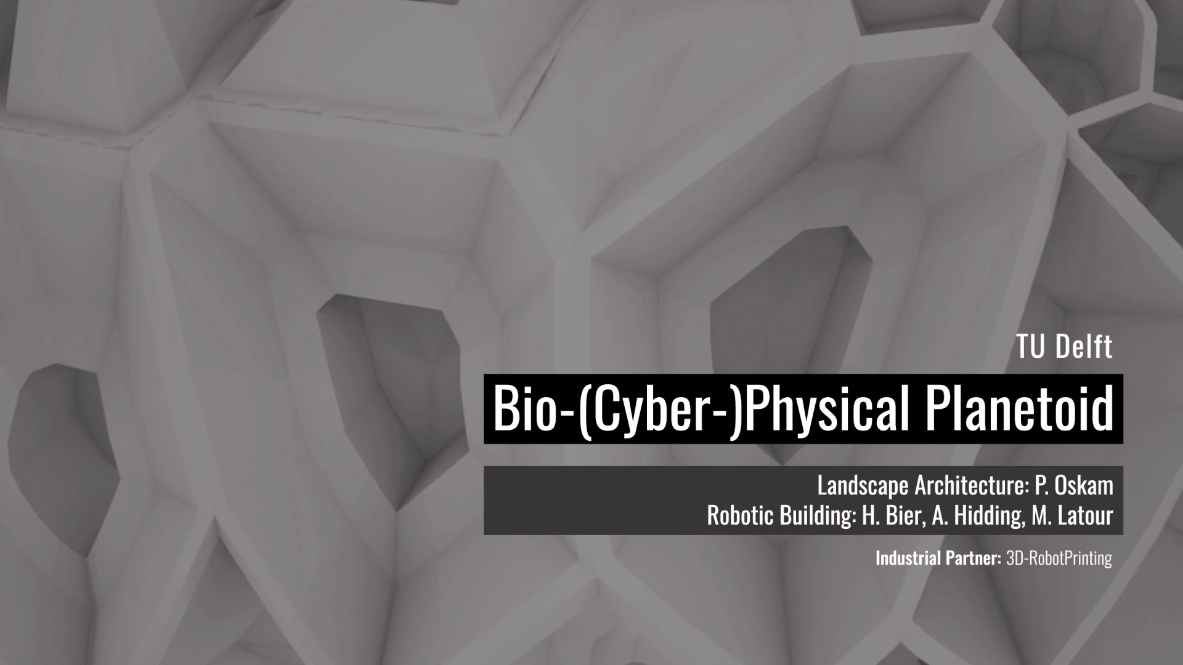
Notes:
And 1:1 scale by prototyping a fragment

